Slide 1
Cloud Readiness Assessment – Cloud Accelerators and Inhibitors
Highlighted below are they key factors that determine whether an application is suitable for Cloud or not
Accelerators
Highlighted below are factors that would signify that workloads are Cloud suitable.
Inhibitors
Highlighted below are factors that would hinder the suitability of a workload for Cloud.
Dev/Test Environments – Sandbox environments can be easily scaled up or torn down on demand in the Cloud and are prime candidates for migration.
High Network Throughput Applications – Applications with high throughput requirements may see performance issues and latency if they are located away from their users.
Infrequently Accessed Storage Archives – It can be more cost effective to host large storage volumes that do not require frequent or immediate access.
Heavily Integrated Applications – Applications that are heavily integrated will continue to require a high amount of communication or dependencies with their counterparts. In this case it is recommended that they remain together, be it in the Cloud or on premise.
Cloud Suitable
Less Cloud Suitable
Please note, inhibitors are not part of the ideal answer, and have only been included here for reference.

Slide 2
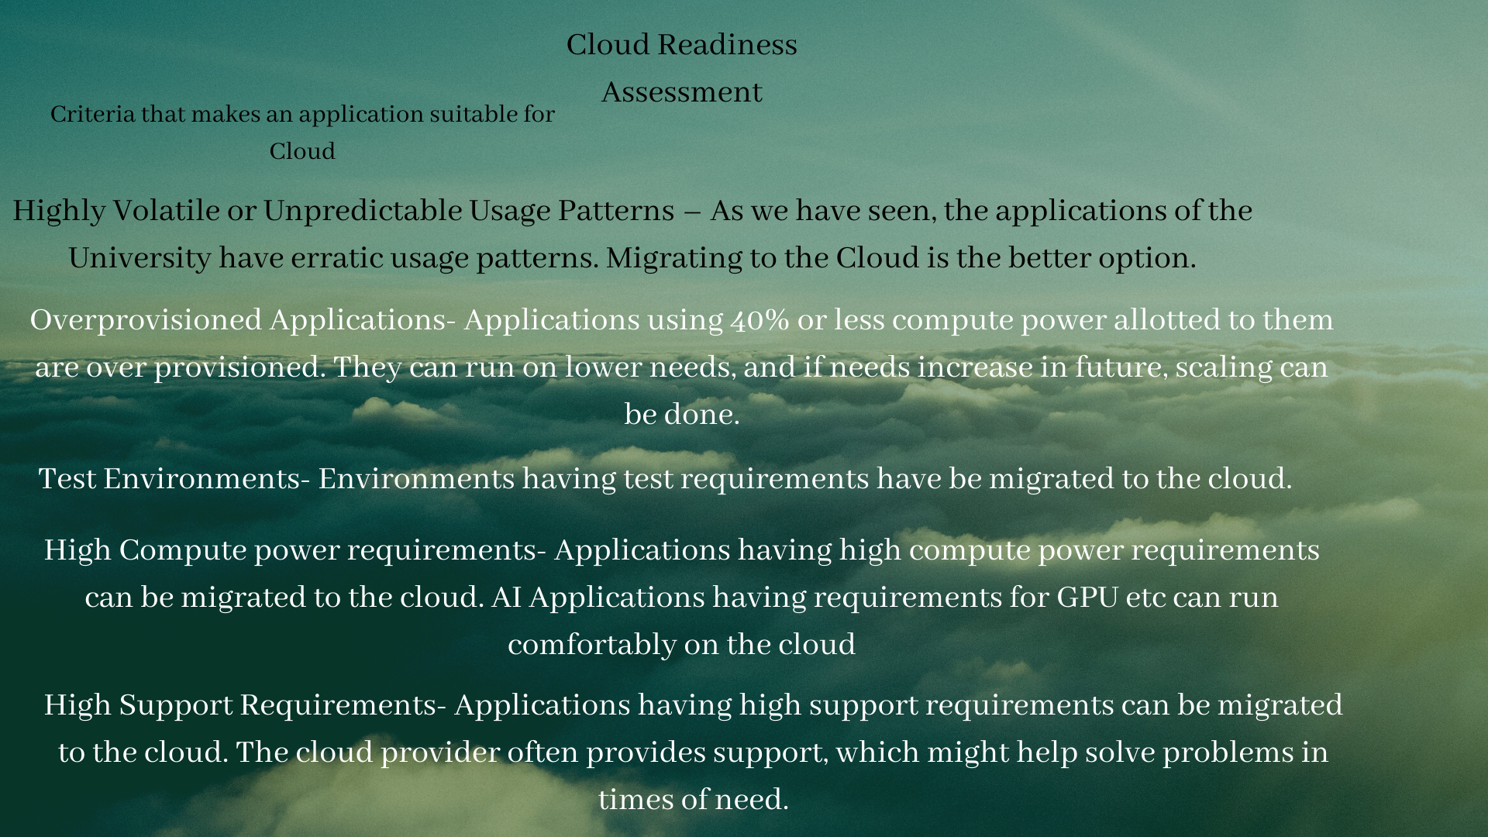

Slide 3
Cloud Readiness Assessment – Application Prioritisation
Highlighted below are the applications that should be prioritised for the Cloud Proof of Concept and a brief justification as to why
Priority | Application | Justification
1 | Enrolments Plus | The enrolments application would be highly volatile in its usage, with a lot of activity at the start of the term followed by minimal use throughout.
2 | Echo360 | Echo360 is used to stream videos and audio content from lectures to students. It has highly volatile use which is well suited to the scalability and elasticity of Cloud Infrastructure.
3 | SharePoint | SharePoint has existing Saas offerings which accelerate its transition to cloud.
4 | Confluence | It is somewhat volatile but does not have much in the ways of integration or sensitive data.
5 | Student Feedback Survey | It is a simpler application with a low degree of integration, minimal data and only moderate customisation.

